Slide 1
CptS 327
Authentication
Notes:
Template-WSU Hrz 201.ppt

Slide 2
Today’s Topics
Authentication Factors
  Passwords
  Secret Questions
  Biometrics
  Tokens
Network Auth Protocols
  Challenge Response
  Needham-Schroeder
  Kerberos
  OpenID
Notes:
Template-WSU Hrz 201.ppt

Slide 3
Cracking Passwords
Assume: attacker gets access to a password file
File can be brute-forced to crack the hash
  1 high-end GPU: 8.2x(10^9) passwords/sec
Rainbow table
  Large public dictionary of hash to password translation
  Significantly reduces processing time
  Contains 99.9% of Windows LM hashes (until XP)
Notes:
Template-WSU Hrz 201.ppt

Slide 4
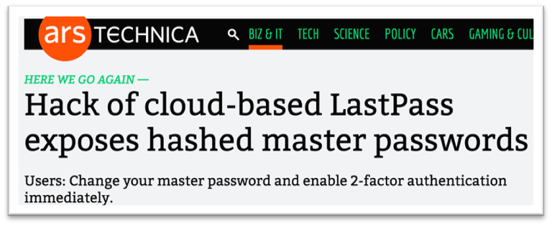

Password Managers
Better to use local pwd managers
Cloud pwd managers are more vulnerable
Notes:
Template-WSU Hrz 201.ppt

Slide 5
Are strong passwords secure?
Yes
https://www.usenix.org/legacy/event/hotsec07/tech/full_papers/florencio/florencio.pdf
6-digit pins are sufficient
  if 3 strikes lockout rule is enforced
  Less than 1% chance of password being cracked
Notes:
Template-WSU Hrz 201.ppt

Slide 6
Secret / Security Questions
Information that’s not easily available
  Ideally, info that’s never available
Problem: ‘secret’ is relative
  Some secrets are easy to guess
  Some are easy to crack
  Others are forgotten in time
History of exploits
  Sara Palin’s email account (guessing, brute-force)
  Mat Honan’s hack adventure (clever engineering chain)
Notes:
Template-WSU Hrz 201.ppt

Slide 7
Matt Honan’s Hack Chain
  A Twitter account
  Pw reset
  A Gmail account
  Pw reset
  An Apple account
  Pw reset required
  Amazon Tech provides last 4 cc #s
4 cc #s, email addr, billing addr
  An Amazon account
Notes:
Template-WSU Hrz 201.ppt

Slide 8
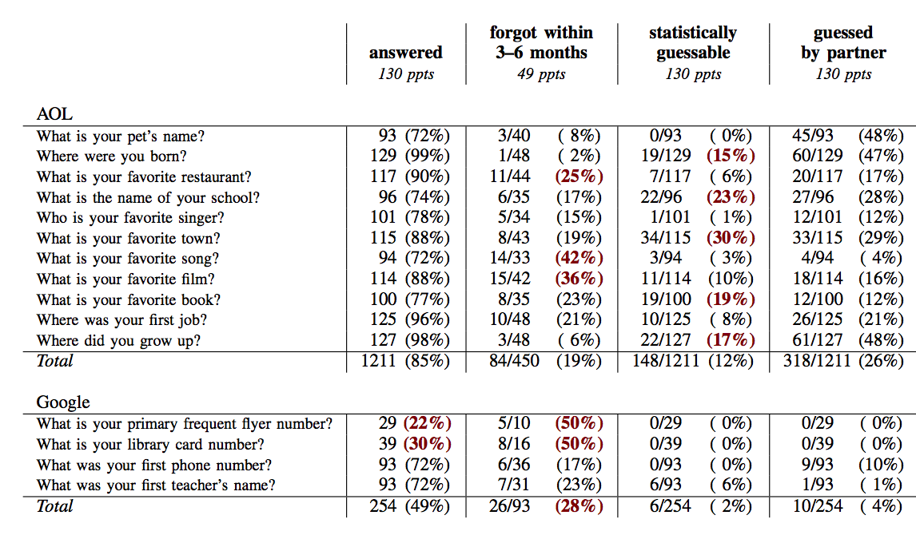
Secret / Security Questions
Notes:
Template-WSU Hrz 201.ppt

Slide 9
Biometrics
Examples
  Iris, fingerprint, hand geo, voice, etc.
Advantages
  No issue of remembrance
  No issue of additional security equipment (no tokens, OTP)
Problems
  Expensive to implement
  Complex to accurately compute
    Most implementations have low accuracy
  Privacy issues
  Can’t change
Notes:
Template-WSU Hrz 201.ppt

Slide 10
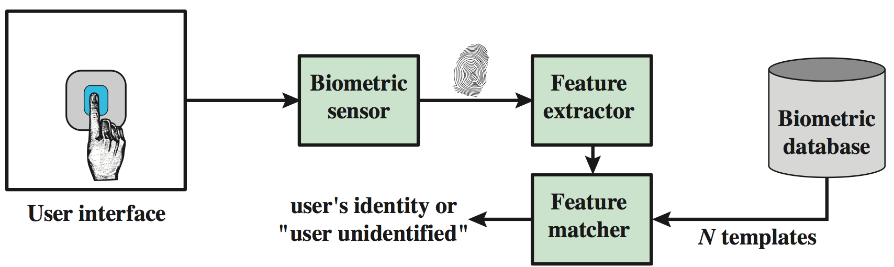
Biometrics
Reading and verification of biometrics
  Done by algorithms
  Riddled with errors / low accuracy
  Hard to replicate patterns everyday
    Dirty hands, teary eyes, finger not in the same angle
Notes:
Template-WSU Hrz 201.ppt

Slide 11
Biometrics: Binary Classification
Authentication
Success
Authentication
Failure
Authentic
User
True Positive
False Negative
(false non-match)
False Positive
(false match)
Attacker
True Negative
Notes:
Template-WSU Hrz 201.ppt

Slide 12
Biometrics: Accuracy Tradeoffs
Higher match threshold (match rate > 65%)
  Higher security
  Higher false non-matches
    Users are frustrated
Lower match threshold (match rate < 60%)
  Lower security
  Higher false match
    Prevalence of unauthorized access increases
Notes:
Template-WSU Hrz 201.ppt

Slide 13
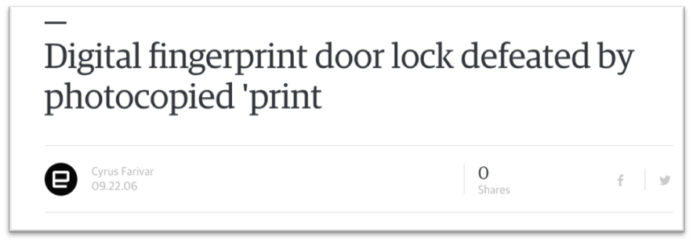
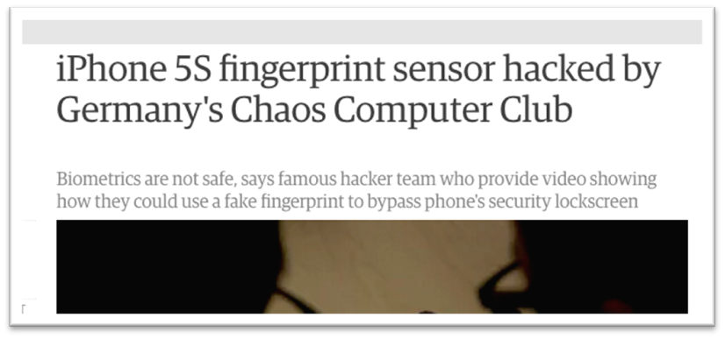
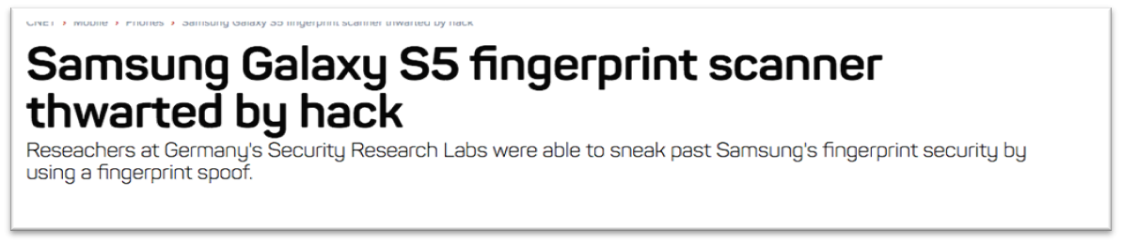
Biometrics: Accuracy Problems
Notes:
Template-WSU Hrz 201.ppt

Slide 14
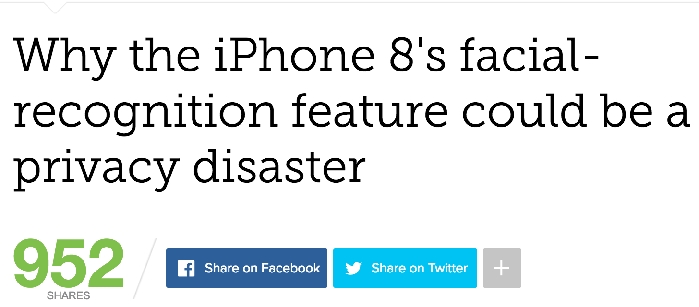
Biometrics: Privacy Problems
Issues:
  Faces maybe similar
  Face information is widely available
  Camera must be ”always on”
Notes:
Template-WSU Hrz 201.ppt

Slide 15
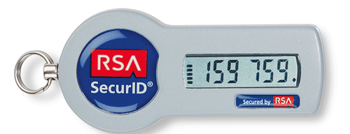
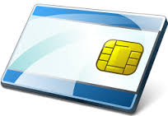
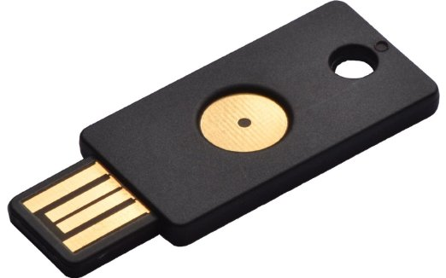
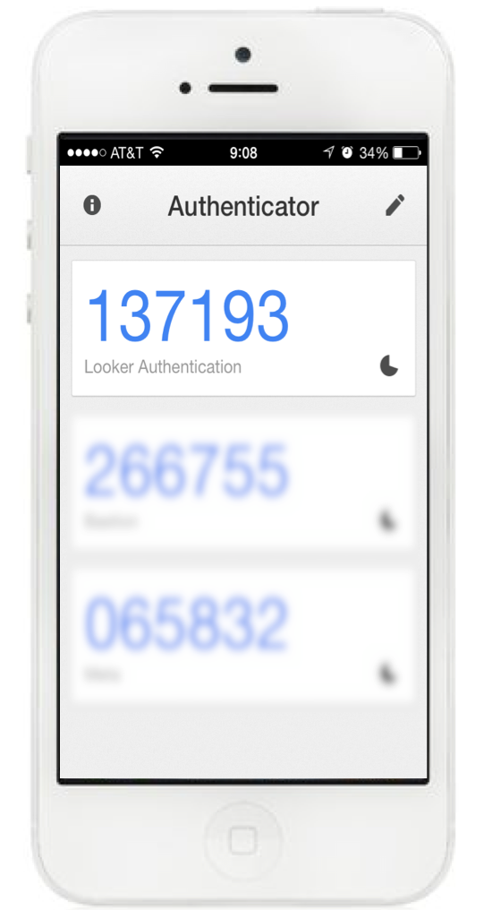
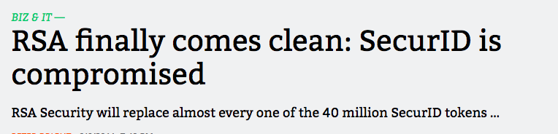
Tokens
Examples
  RSA SecureID
    OTP in sync with servers
  Smart cards
    Embedded crypto processor
  Phones
    SMS messages
Advantages: accurate than biometrics
Problems
  Can be lost, stolen, cracked
Notes:
Template-WSU Hrz 201.ppt

Slide 16
SMS Authentication
Receive an OTP to your phone
Use OTP to access a service
The service usually has username/password as well
Is this secure?
Notes:
Template-WSU Hrz 201.ppt

Slide 17
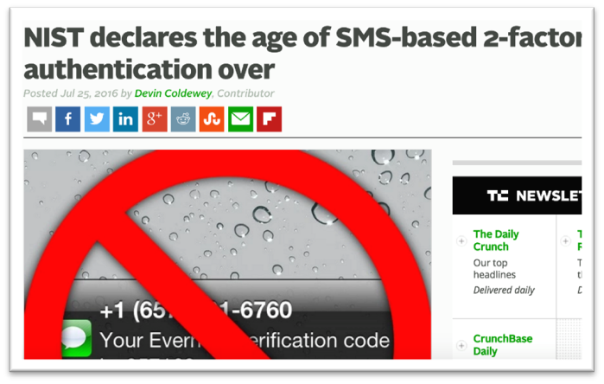
SMS Authentication
Debated about SMS being a factor in MFA
SMS messages can be re-directed easily
  VoIP, account redirect with mobile carrier
Notes:
Template-WSU Hrz 201.ppt

Slide 18
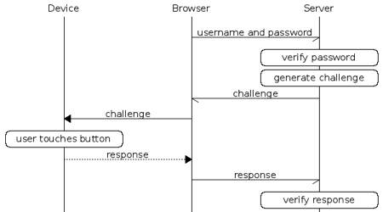
Fast Identity Online (FIDO) Alliance
Emerging MFA online standard
  Governs websites, web apps
  Supports multiple devices
Notes:
Template-WSU Hrz 201.ppt

Slide 19
Network Authentication Protocols
Challenge Response
Needham-Schroeder
Kerberos
OpenID
Notes:
Template-WSU Hrz 201.ppt

Slide 20
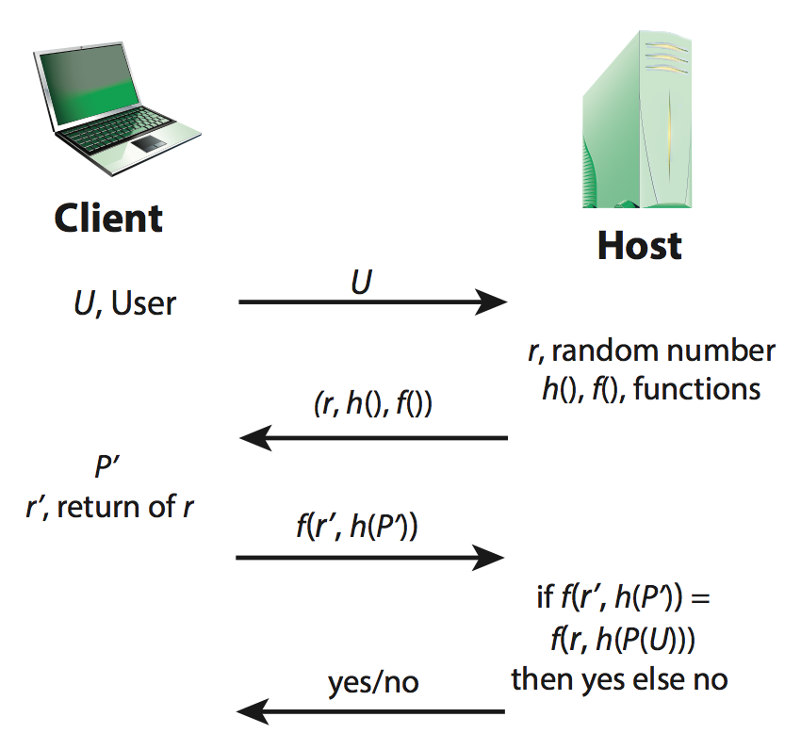
Challenge Response Protocol
U – User
P – Password
r – nonce (random number)
h() – hash function
f() – challenge/response function (probably also a hash fn)
Notes:
Template-WSU Hrz 201.ppt

Slide 21
Challenge Response Protocol
Advantages
  Doesn’t transmit user’s credential, transmits hash
  Uses nonce to randomize every access attempt
Threats
  Eavesdropper
  Replay
  Man in the Middle
Notes:
Template-WSU Hrz 201.ppt

Slide 22
Needham-Schroeder Protocol
Same Schroeder from ‘Security Design Principles’
  Michael Schroeder – WSU grad (1967)
Motivation:
  A & B want to chat but don’t trust each other
  They both trust S
  How to make key sharing possible?
Notes:
Template-WSU Hrz 201.ppt

Slide 23
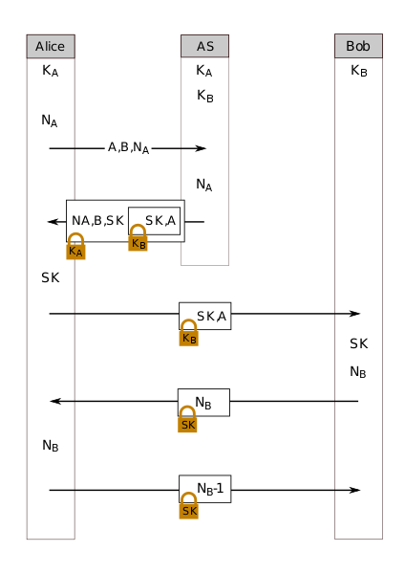
Needham-Schroeder Protocol
S is the trusted server
N_A and N_B are nonces (rand numbers)
K_A is the symmetric key of A
K_B is the symmetric key of B
SK is the symmetric key generated by S, to be used by A and B for their session
Notes:
Template-WSU Hrz 201.ppt

Slide 24
Needham Schroeder Protocol
Uses third party to authenticate two users
Uses shared keys
Problems:
  Replay attack
    If K_(AB) is compromised
Basis for Kerberos Protocol
Notes:
Template-WSU Hrz 201.ppt

Slide 25
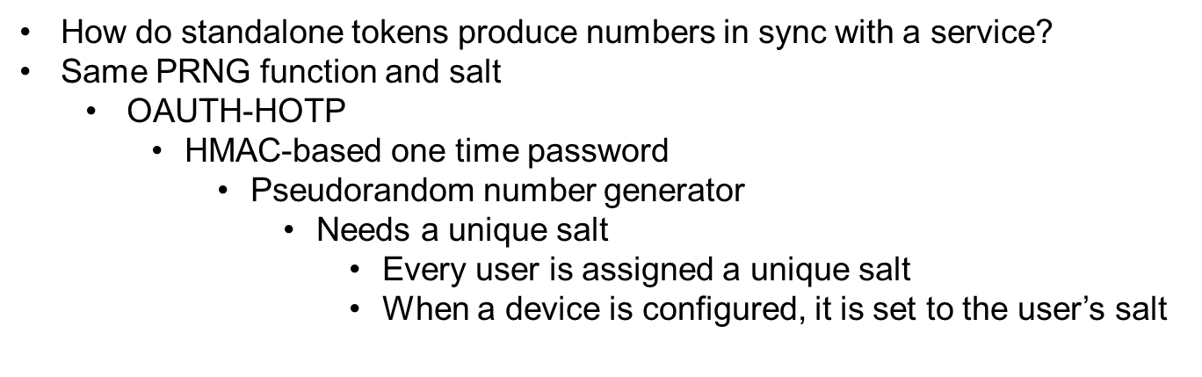
Standalone Tokens
Notes:
Template-WSU Hrz 201.ppt

Slide 26
Kerberos Protocol
Motivation:
  Credential storage on systems?
    Can’t store all credentials on all systems for a cloud app
Example: University accounts
Solution: single authentication server
Popular for network auth (e.g. MS AD)
Notes:
Template-WSU Hrz 201.ppt

Slide 27
Kerberos Terminology
Authentication Server (AS)
  Authenticates each user's database of all users/passwords
Ticket
  credential used to authenticate systems
Ticket-Granting Server (TGS)
  Validates TGTs and provides service tickets
Ticket-Granting Ticket (TGT)
  Used to obtain a service ticket from TGS
Authenticator
  Verifies sender of ticket is same as entity included in ticket
Notes:
Template-WSU Hrz 201.ppt

Slide 28
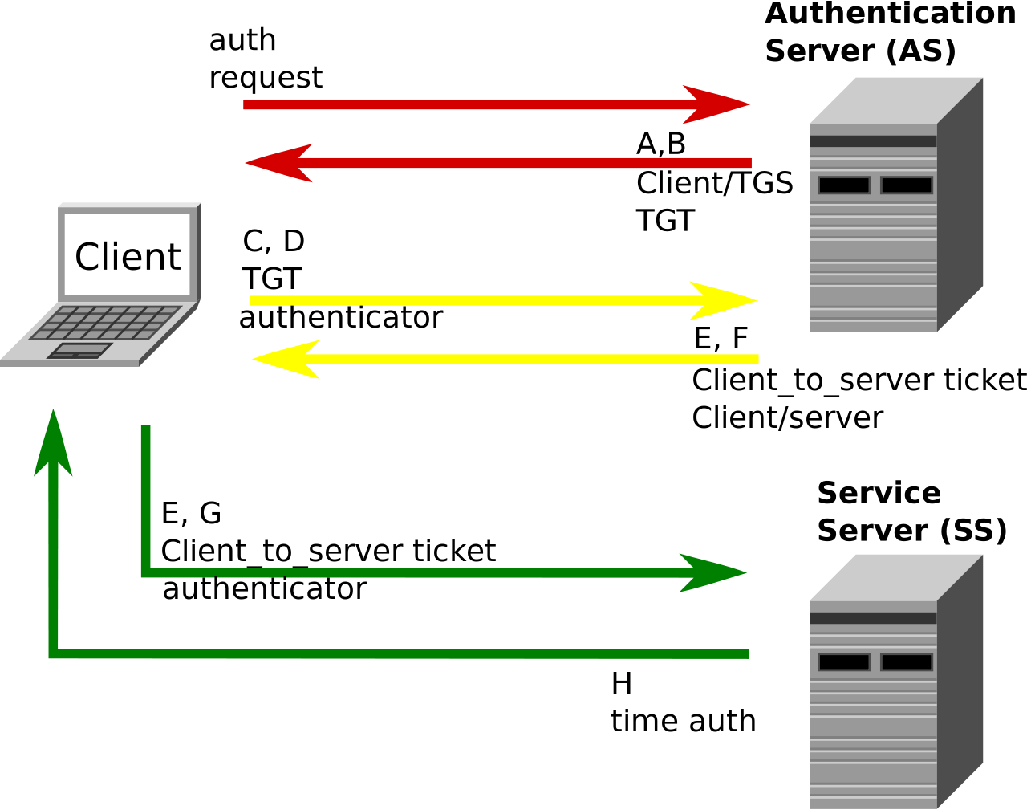
Kerberos Terminology

Slide 29
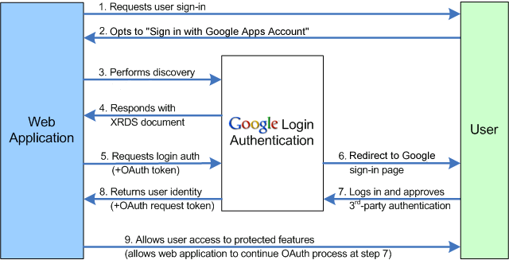
OpenID Protocol
Provides trusted third-party services for authentication
Notes:
Template-WSU Hrz 201.ppt

Slide 30
OpenID Protocol
Multiple sub-protocols
  Oauth, XRDS
Problems
  Trust
  Privacy (service sees all the sites you visit)
  Companies store your web traffic data
    Data is $$$$
Notes:
Template-WSU Hrz 201.ppt

Slide 31
Authentication Protocols
MFA apps are still insecure
Vulnerable to
  Phishing
  Trojan / malware
Evidence for cracking MFA exists
  https://www.schneier.com/blog/archives/2005/03/the_failure_of.html
Notes:
Template-WSU Hrz 201.ppt

Slide 32
Next lecture
Access Control
Notes:
Template-WSU Hrz 201.ppt

Slide 33
Any questions?
Notes:
Template-WSU Hrz 201.ppt

